Slide 1


Human Voice Activity Detection with Deep Learning
Amir Ivry

Slide 2
About Me
Leading AI R&D @ PMO (5y)
PhD Candidate @ Technion – IIT
Chief editor @ interviews.ai
AI Consultant for startups

Slide 3


Agenda
The challenge
Formulation
Method
Results
Competing state-of-the-art

Slide 4
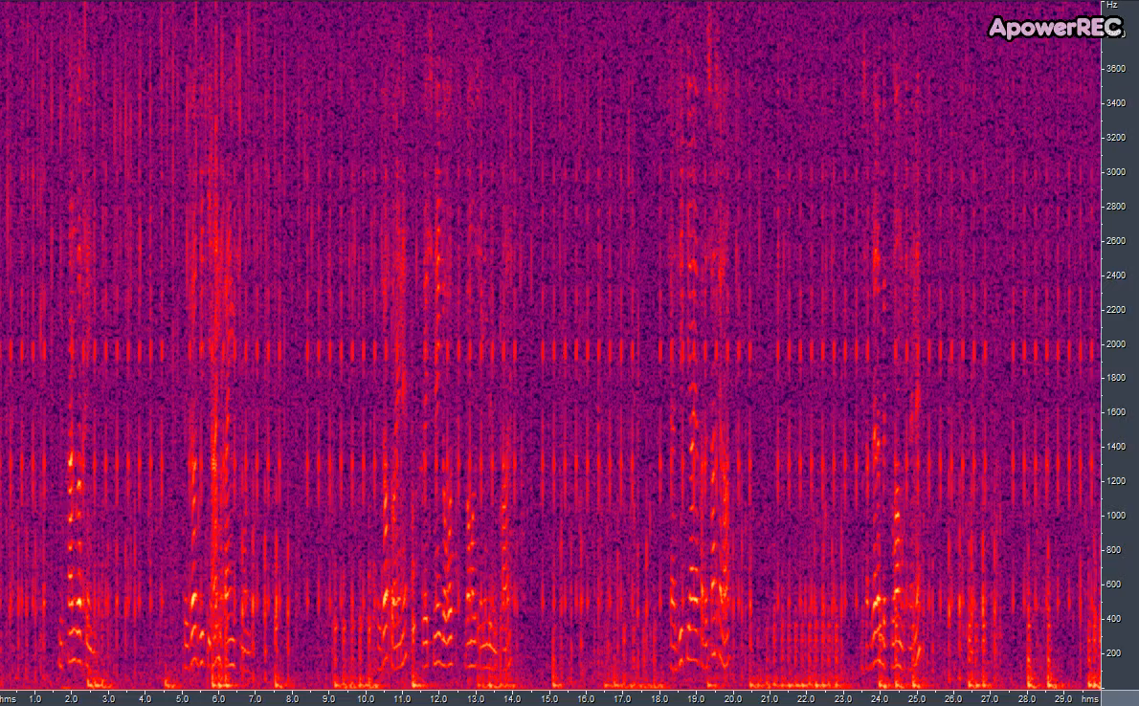
The Challenge

Slide 5

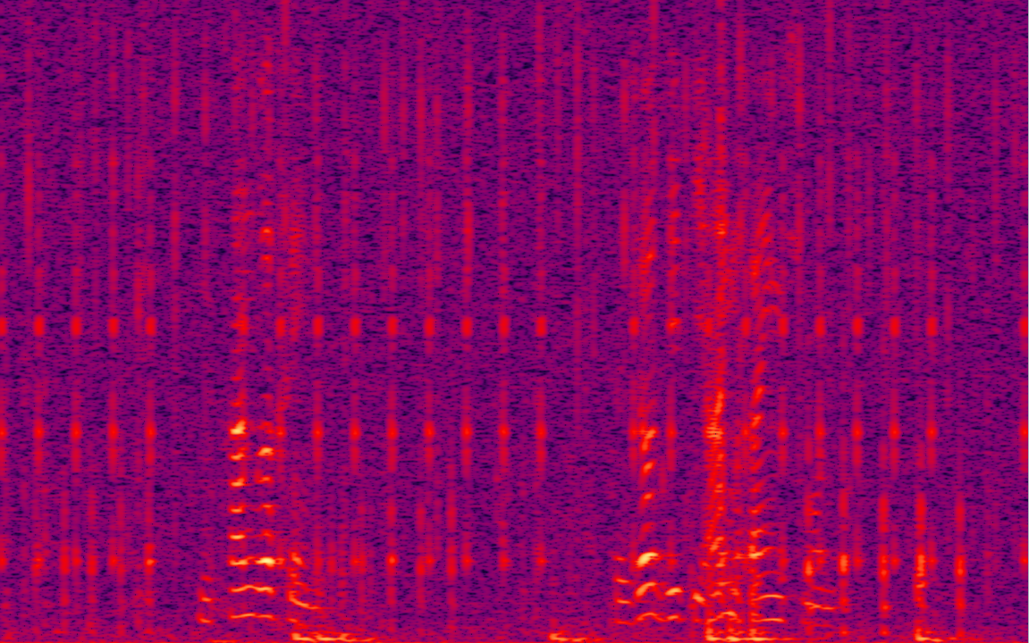
The Challenge - False Negative
Transient interference:
Rapidly vary in time
High energy levels
Dominant & screen speech
May lead to loss of information

Slide 6
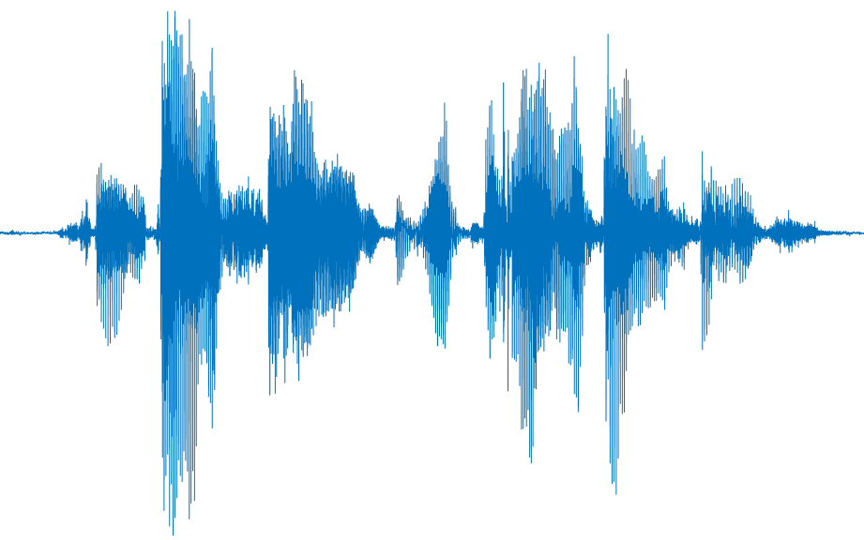
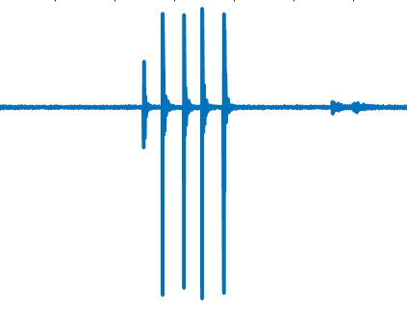
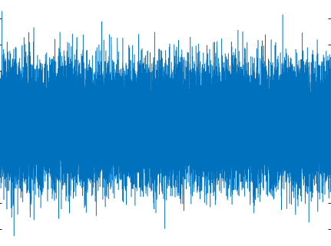
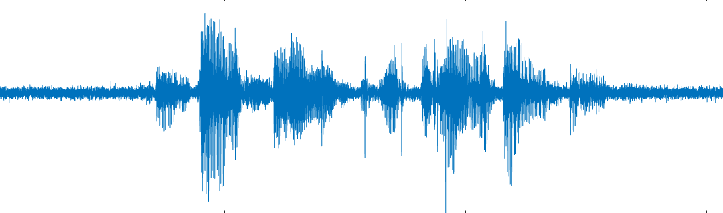
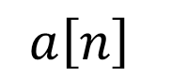
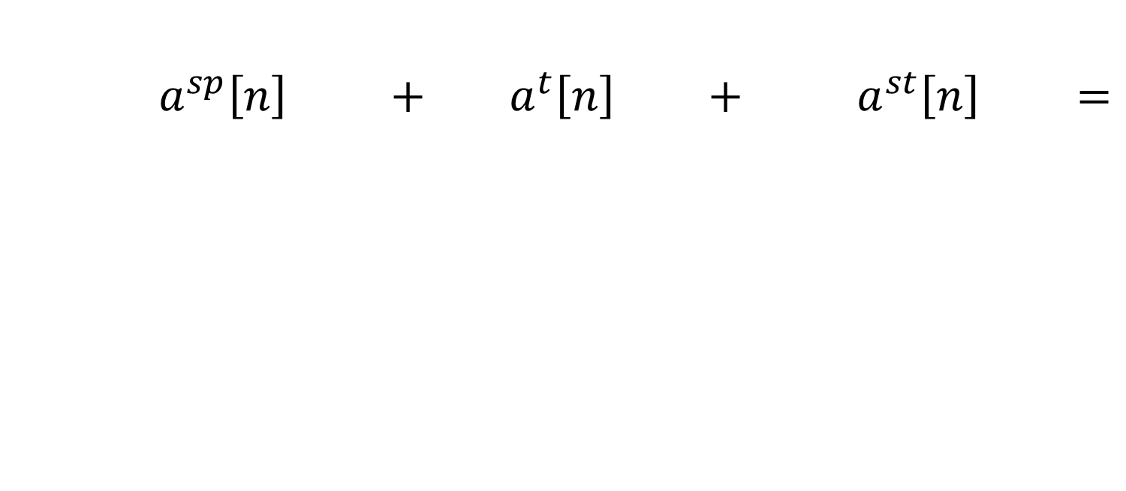
Problem Formulation
$a^{sp}\left[n\right] + a^{t}\left[n\right] + a^{st}\left[n\right] =$
$$a\left[n\right]$$

Slide 7
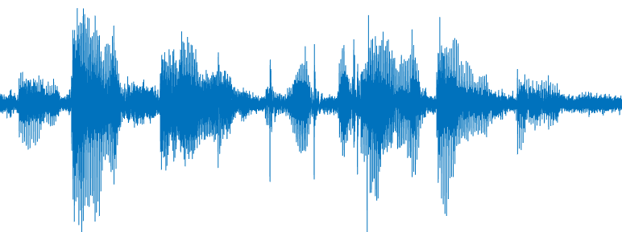
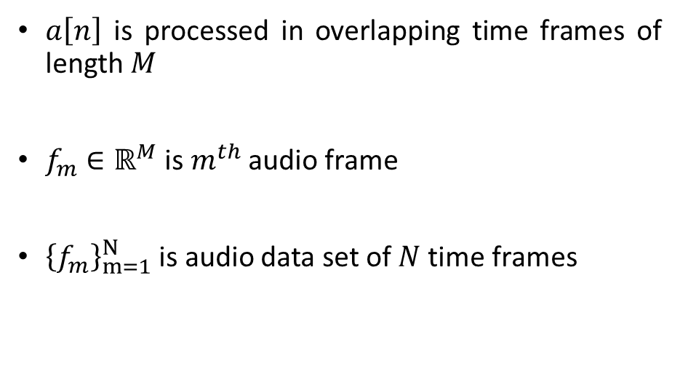
Problem Formulation
$a\left[n\right]$ is processed in overlapping time frames of length $M$
$f_{m}∈ℝ^{M}$ is $m^{th}$ audio frame
${\left\{f_{m}\right\}}_{m=1}^{N}$ is audio data set of $N$time frames

Slide 8

Problem Formulation
Speech presence $H_{1}$ or absence $H_{0}$ determined by $a^{sp}[n]$
$I(f_{m})$ is speech indicator of the $m^{th}$ frame:
$$I(f_{m})=\left\{\begin{aligned}1, if f_{m}∈H_{1} \\ &0, if f_{m}∈H_{0}\end{aligned}\right.$$

Slide 9

Problem Formulation
The goal of this study is to estimate $I\left(f_{m}\right)$

Slide 10
Features Toolbox

Slide 11
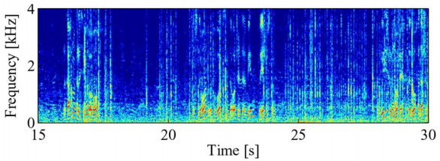
Mel Frequency Cepstral Coefficients (MFCCs)
Time-Frequency representation of raw audio frames using filter-bank
Frames weighted by likelihood of noise in frame
Past context of 32ms

Slide 12
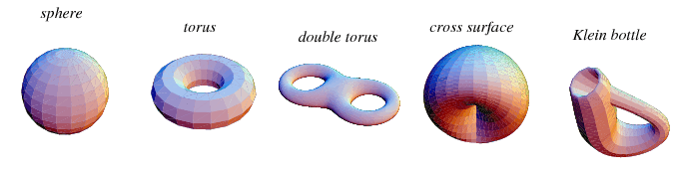
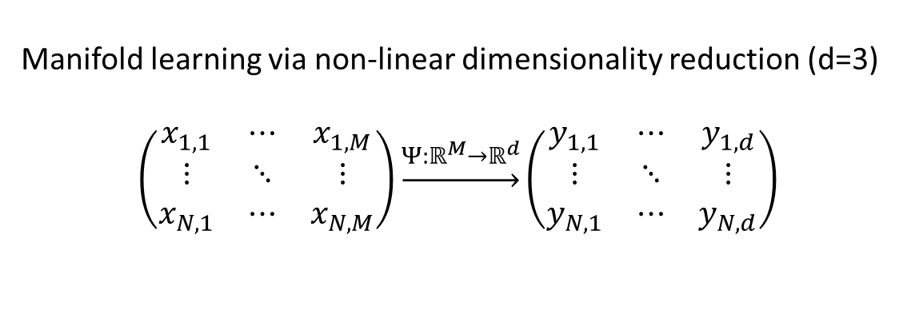
Diffusion Maps
Manifold learning via non-linear dimensionality reduction (d=3)
$$\left(\begin{matrix}x_{1,1} & ⋯ & x_{1,M} \\ ⋮ & ⋱ & ⋮ \\ x_{N,1} & ⋯ & x_{N,M}\end{matrix}\right)\underset{→}{Ψ:ℝ^{M}→ℝ^{d}}\left(\begin{matrix}y_{1,1} & ⋯ & y_{1,d} \\ ⋮ & ⋱ & ⋮ \\ y_{N,1} & ⋯ & y_{N,d}\end{matrix}\right)$$

Slide 13
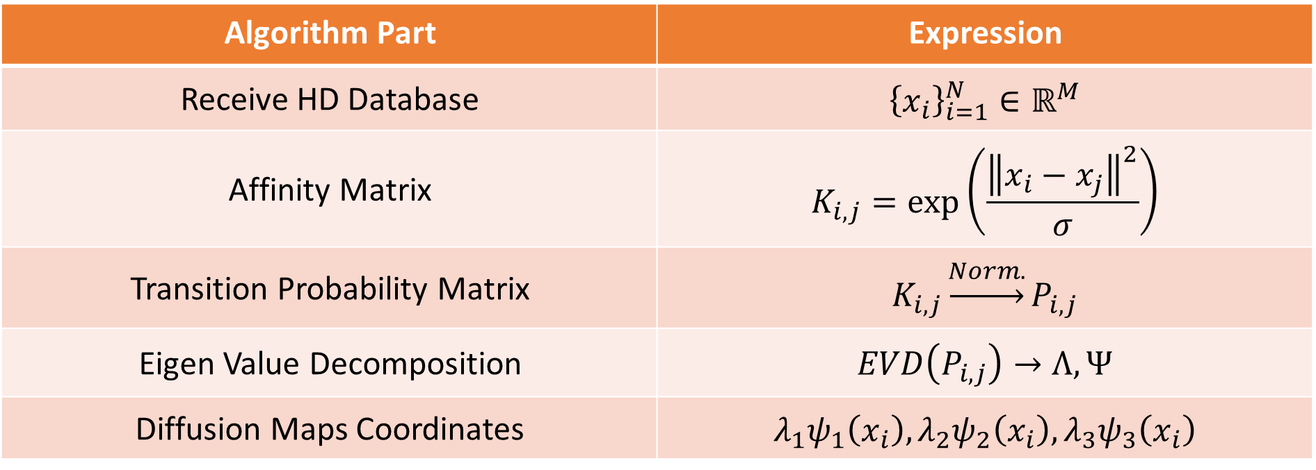
Diffusion Maps Basic Algorithm
Expression | Algorithm Part
$${\left\{x_{i}\right\}}_{i=1}^{N}∈ℝ^{M}$$ | Receive HD Database
$$K_{i,j}=\exp\left(\frac{{\left\|x_{i}−x_{j}\right\|}^{2}}{σ}\right)$$ | Affinity Matrix
$$K_{i,j}\underset{→}{Norm.}P_{i,j}$$ | Transition Probability Matrix
$$EVD\left(P_{i,j}\right)→Λ,Ψ$$ | Eigen Value Decomposition
$${λ_{1}ψ}_{1}\left(x_{i}\right),λ_{2}ψ_{2}\left(x_{i}\right),λ_{3}ψ_{3}\left(x_{i}\right)$$ | Diffusion Maps Coordinates

Slide 14
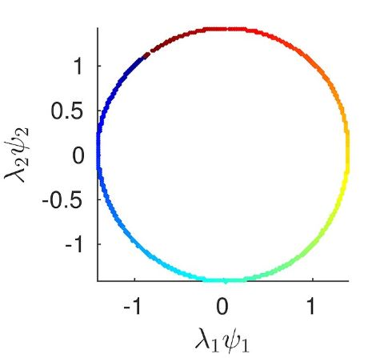
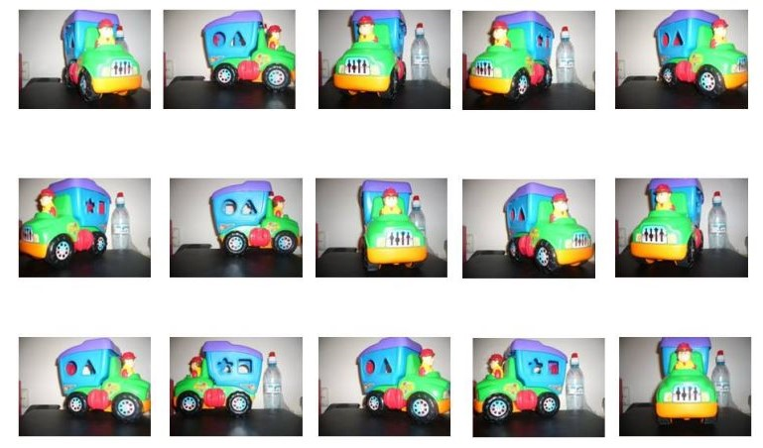
Diffusion Maps - Illustration

Slide 15
Diffusion Maps Desired Properties
Quantifies the diffusion distance: probability of transition between two frames
Diffusion distance in HD equals Euclidean distance in LD

Slide 16
Diffusion Maps Drawbacks
Does not produce mapping from HD to LD as output
Cannot be applied on new data in real time

Slide 17
Deep Learning Based VAD

Slide 18

Fully Connected Neural Network

Slide 19
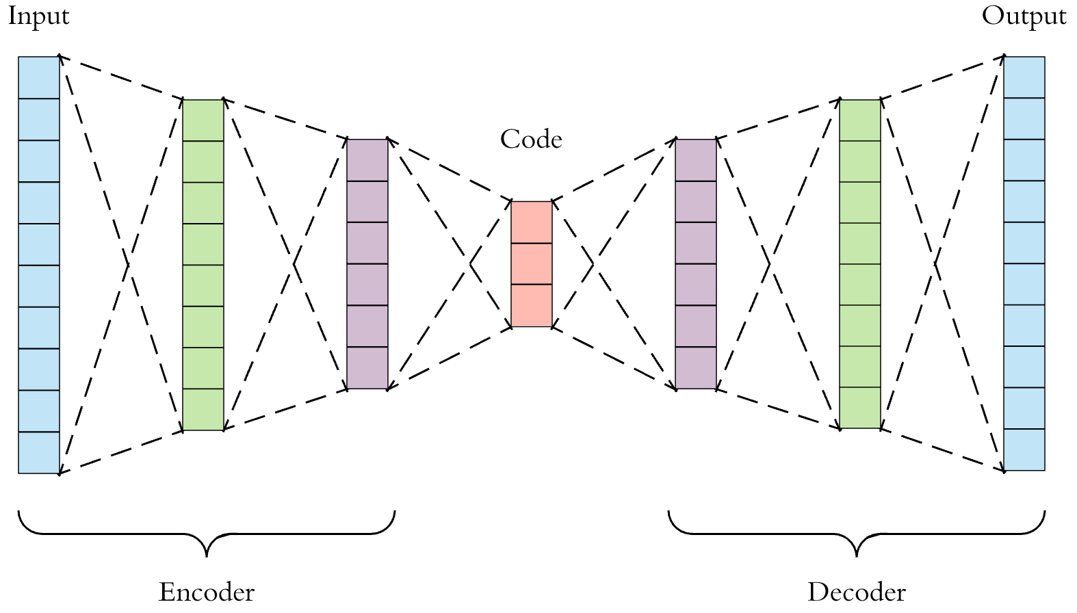
Encoder-Decoder Architecture

Slide 20
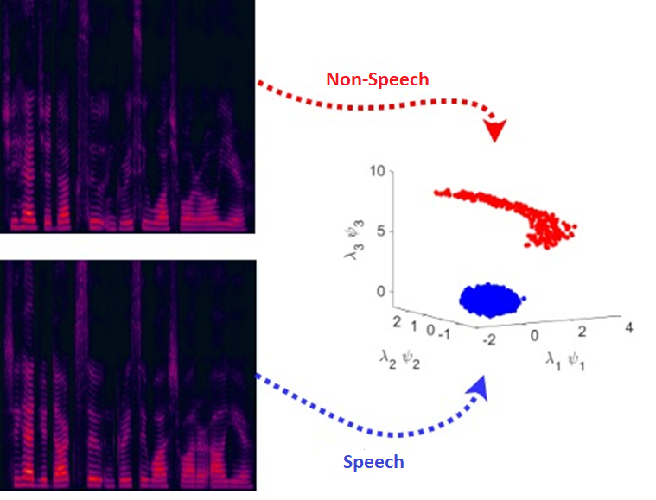
Relation Between Features: Diffusion Maps of MFCC

Slide 21
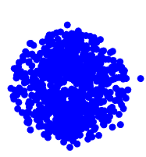
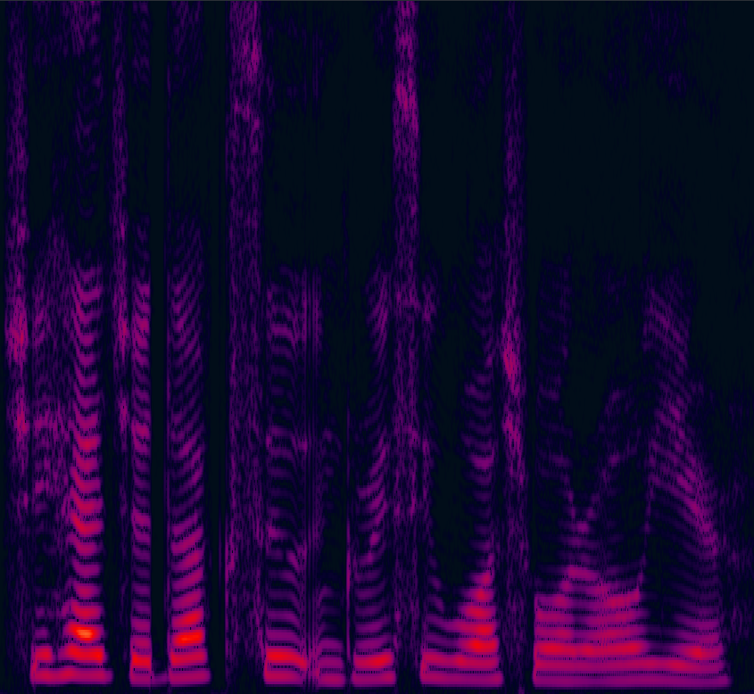
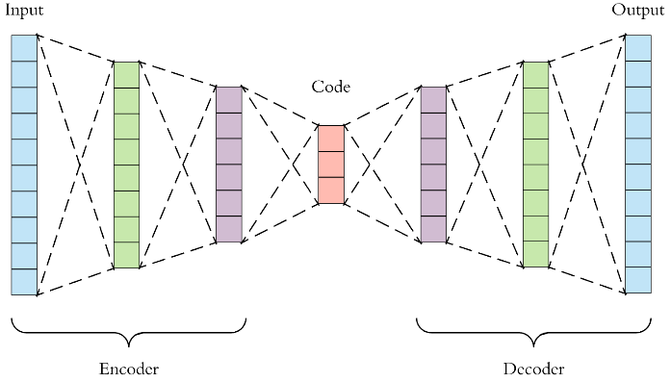
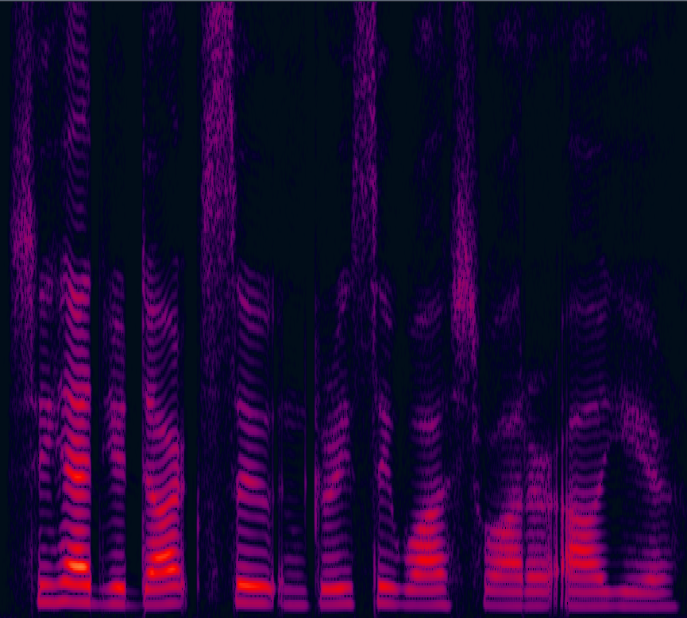
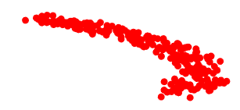
Training Stage A Learning Low Dimensional Code

Slide 22
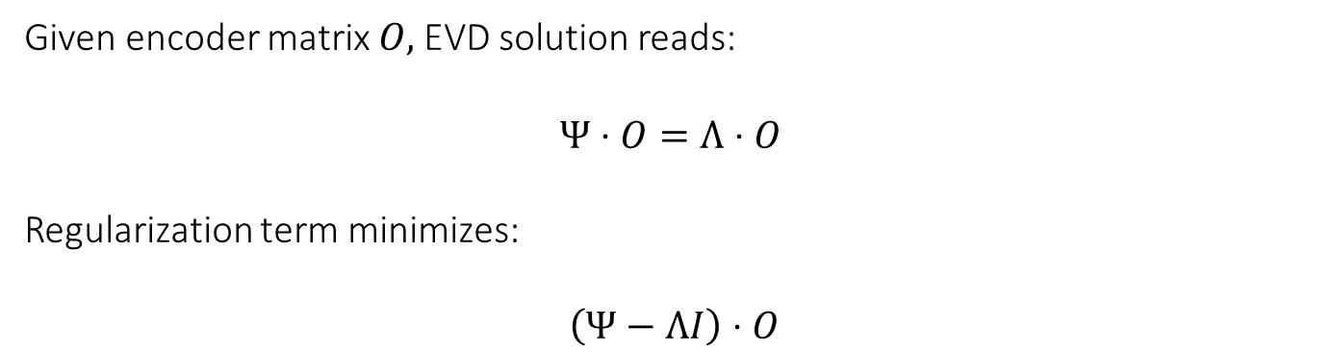
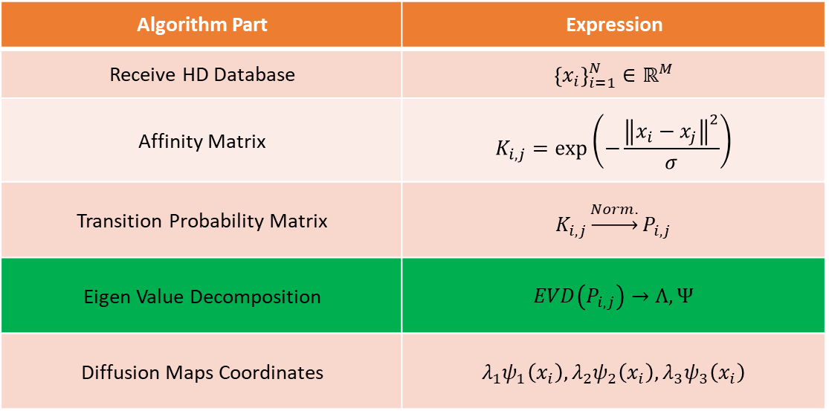
Diffusion Maps Regularization
Given encoder matrix $O,$EVD solution reads:
$$Ψ⋅O=Λ⋅O$$
Regularization term minimizes:
$\left(Ψ−ΛI\right)⋅O$
Expression | Algorithm Part
$${\left\{x_{i}\right\}}_{i=1}^{N}∈ℝ^{M}$$ | Receive HD Database
$$K_{i,j}=\exp\left(−\frac{{\left\|x_{i}−x_{j}\right\|}^{2}}{σ}\right)$$ | Affinity Matrix
$$K_{i,j}\underset{→}{Norm.}P_{i,j}$$ | Transition Probability Matrix
$$EVD\left(P_{i,j}\right)→Λ,Ψ$$ | Eigen Value Decomposition
$${λ_{1}ψ}_{1}\left(x_{i}\right),λ_{2}ψ_{2}\left(x_{i}\right),λ_{3}ψ_{3}\left(x_{i}\right)$$ | Diffusion Maps Coordinates

Slide 23
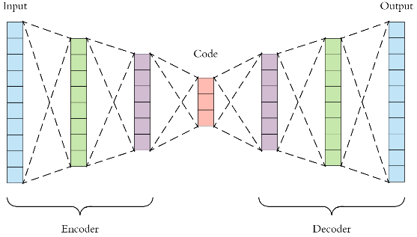
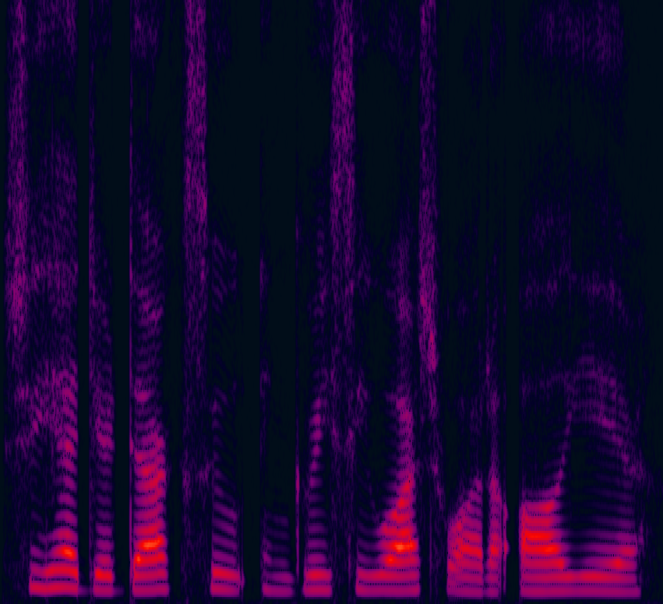
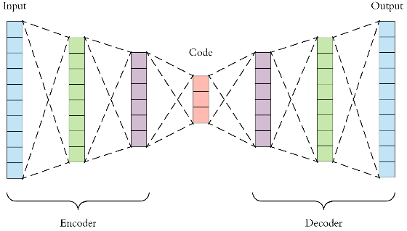


Training Stage B Learning the Error Map
Top Prediction
Top Error
$${ ℓ}_{1}$$
$${ ℓ}_{1}$$
Bottom Prediction
Bottom Error

Slide 24
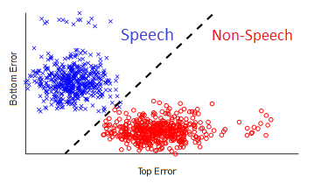
Training Stage B Learning the Error Map
Top Error
Bottom Error

Slide 25
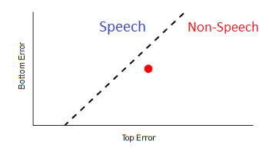
Real-time Test on Unseen Data
Top Error
Bottom Error

Slide 26
Performance

Slide 27
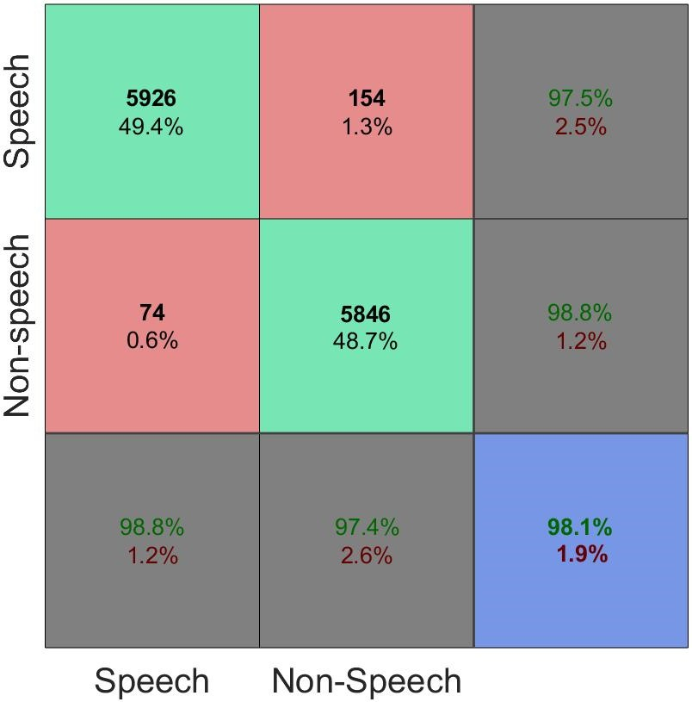
Accuracy of VAD
Output
Target

Slide 28
Robustness of VAD

Slide 29
Generalization with Missing and Imbalanced Data

Slide 30
Comparison to State-of-the-art

Slide 31
Embedding of Core Algorithm

Slide 32
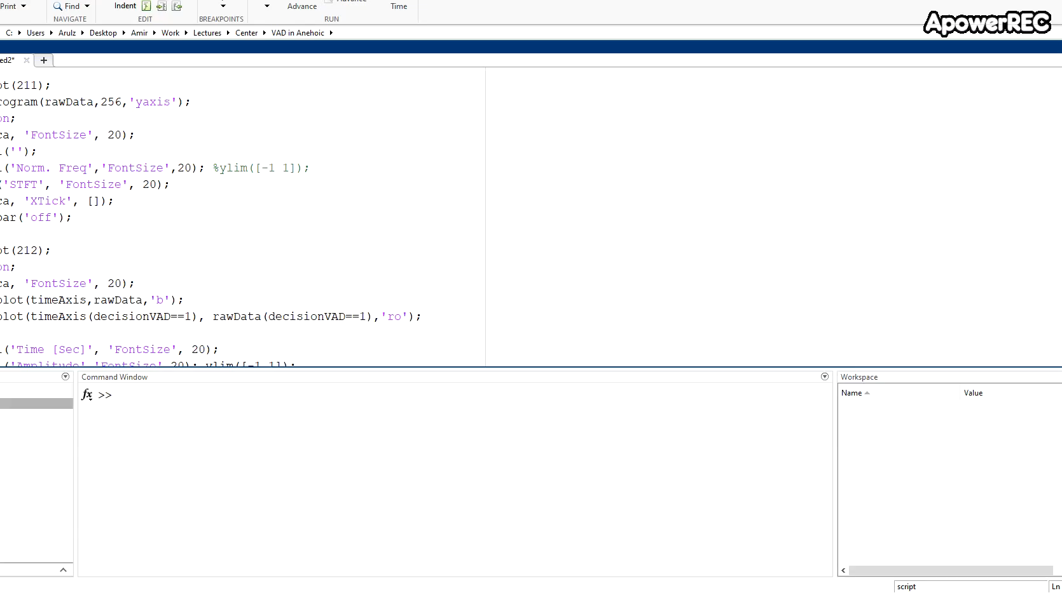
Human Voice Activity Detection

Slide 33
Information and Contact
LinkedIn | Personal Website | E-mail | Google Scholar
Amir Ivry | sivry.webgr.technion.ac.il | amirivry@gmail.com | Amir Ivry
Available Publication:
“Voice Activity Detection for Transient Noisy Environment Based on Diffusion Nets‏”

